Slide 1
Machine learning in physics Graph neural networks

Slide 2
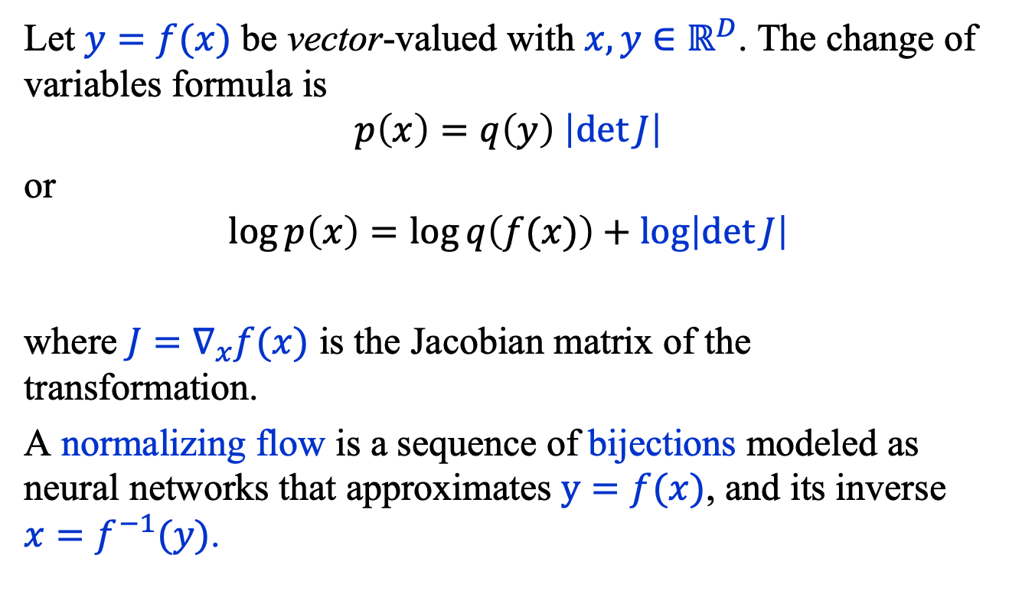
Recap: Normalizing Flows
Let $y=f(x)$ be vector-valued with $x, y∈ℝ^{D}$. The change of variables formula is
$$p\left(x\right)=q\left(y\right) \left|\det{J}\right|$$
or
$$\log{p\left(x\right)}=\log{q\left(f(x)\right)}+\log\left|\det{J}\right|$$
where $J=∇_{x}f(x)$ is the Jacobian matrix of the transformation.
A normalizing flow is a sequence of bijections modeled as neural networks that approximates $y=f(x)$, and its inverse ${x=f}^{−1}(y)$.

Slide 3
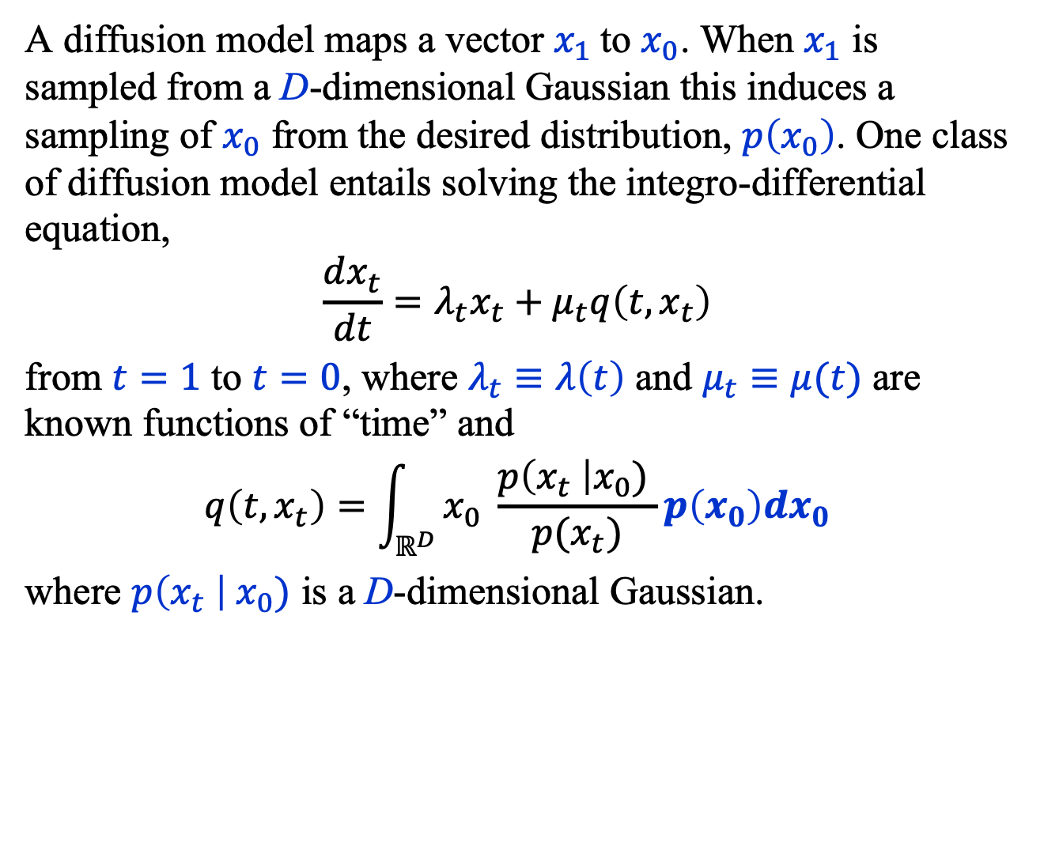
Recap: Diffusion Model
A diffusion model maps a vector $x_{1}$ to $x_{0}$. When $x_{1}$ is sampled from a D-dimensional Gaussian this induces a sampling of $x_{0}$ from the desired distribution, $p\left(x_{0}\right)$. One class of diffusion model entails solving the integro-differential equation,
$$\frac{dx_{t}}{dt}=λ_{t}x_{t}+μ_{t}q\left(t, x_{t}\right)$$
from $t=1$ to $t=0$, where $λ_{t}≡λ\left(t\right)$ and $μ_{t}≡μ(t)$ are known functions of “time” and
$$q\left(t, x_{t}\right)=\int_{ℝ^{D}}{x_{0} \frac{p\left(x_{t} \right|x_{0}) }{p(x_{t})}p\left(x_{0}\right)dx_{0}}$$
where $p\left(x_{t} \right|{ x}_{0})$ is a D-dimensional Gaussian.

Slide 4
Introduction
Convolutional neural networks (CNN)
Autoencoder (AE)
Physics-informed neural networks (PINN)
Flow and diffusion models
Graph neural networks (GNN)
Transformer neural networks (TNN)

Slide 5
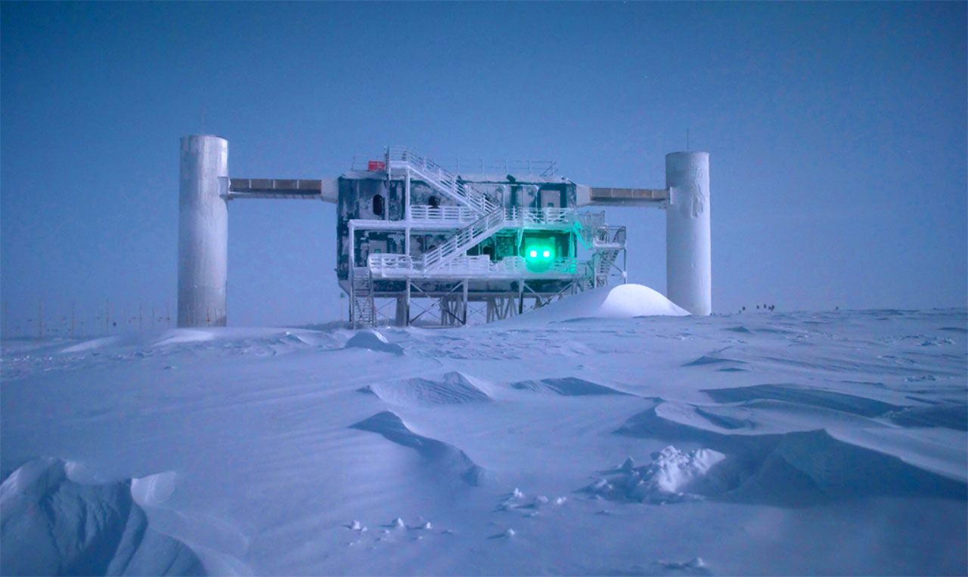
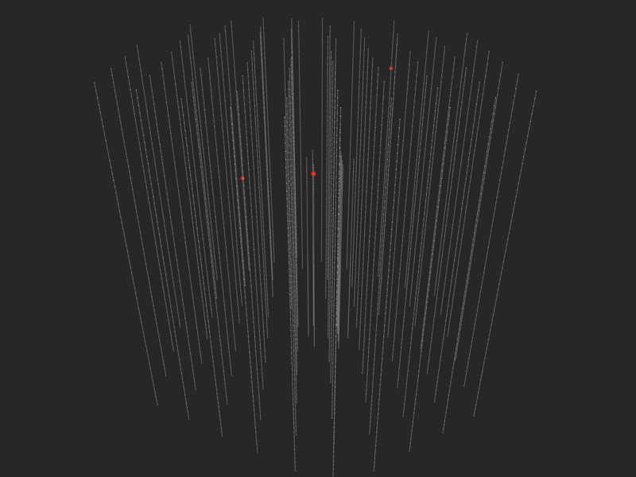
Introduction
Consider the following neutrino event from IceCube.

Slide 6
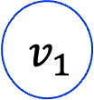
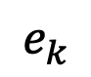
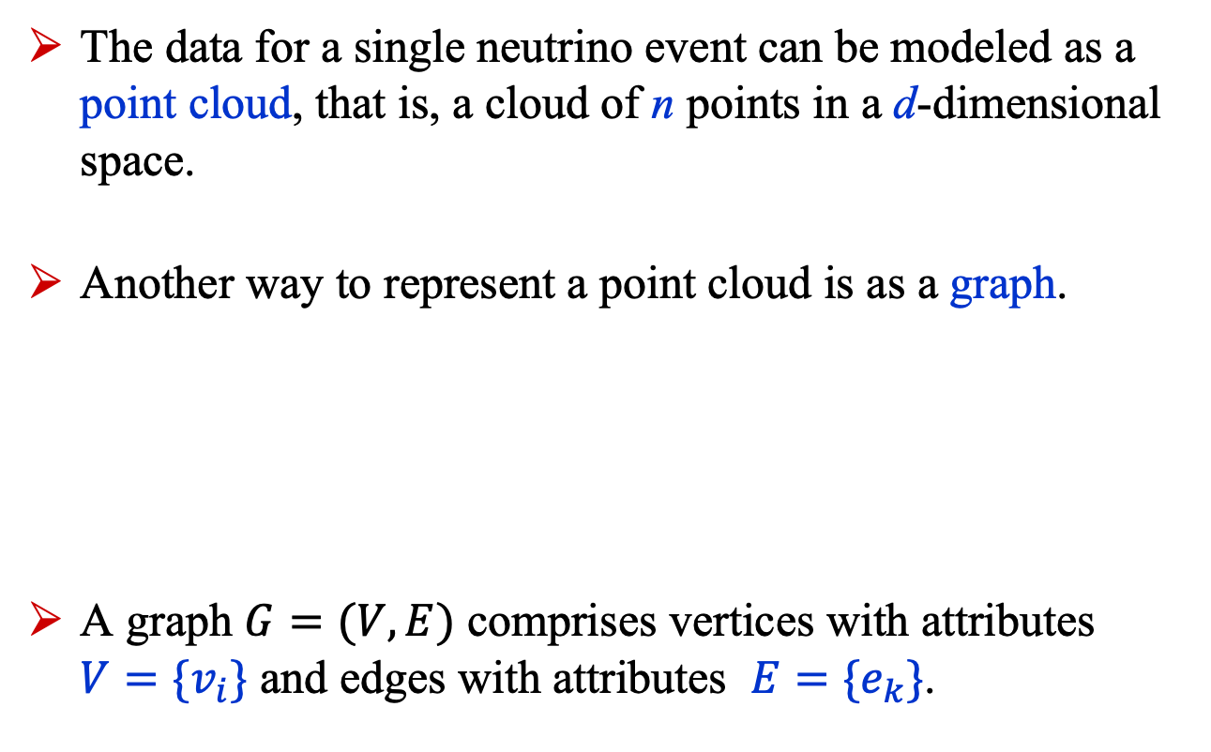
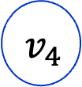
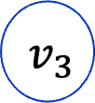
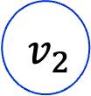
Introduction
The data for a single neutrino event can be modeled as a point cloud, that is, a cloud of n points in a d-dimensional space.
Another way to represent a point cloud is as a graph.
A graph $G=(V, E)$ comprises vertices with attributes ${V=\{v}_{i}\}$ and edges with attributes ${E=\{e}_{k}\}$.
$$v_{2}$$
$$e_{k}$$
$$v_{4}$$
$$v_{1}$$
$$v_{3}$$

Slide 7
Introduction
Standard neural networks expect the input data to be of fixed size.
However, the number of points in a point cloud or the number of vertices in a graph can change from one data instance to the next.
Using the work of the IceCube collaboration, we’ll show how a graph neural network can handle graphs having a varying number of vertices.

Slide 8
Graph neural networks

Slide 9
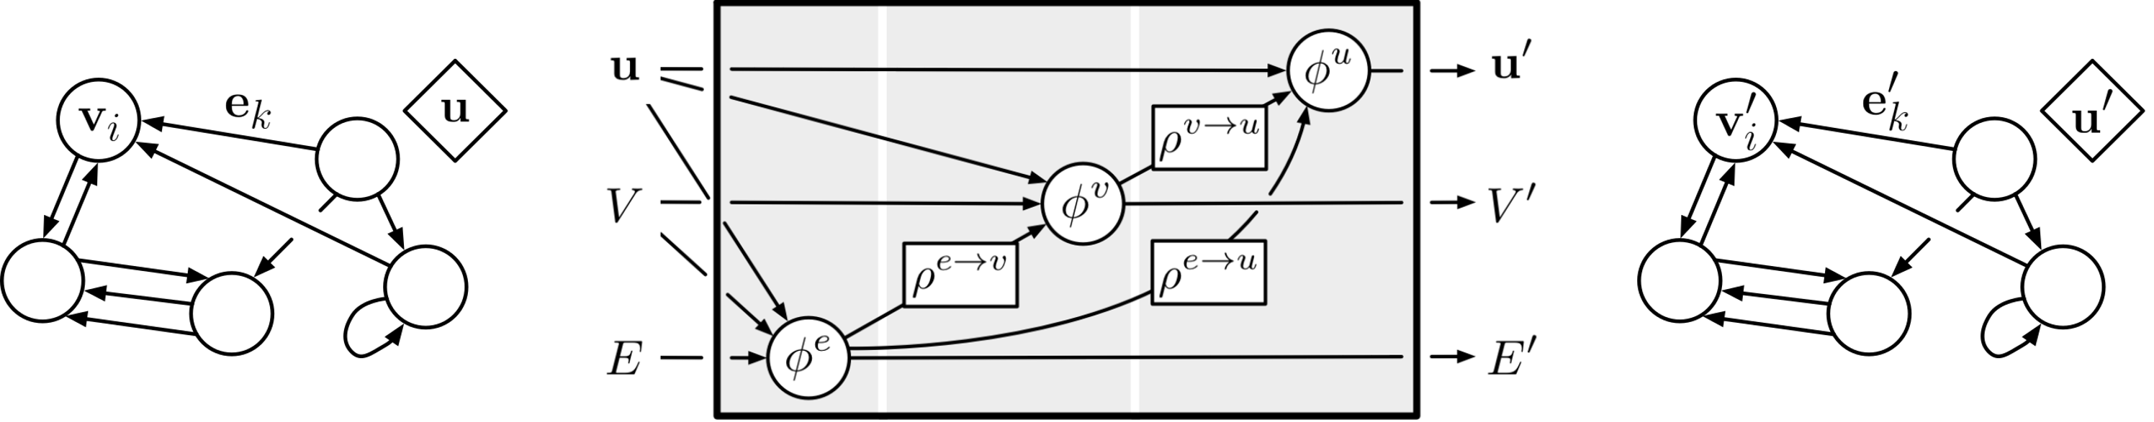
Graph Neural Networks (GNN)
A graph neural network is designed to operate on data organized as a graph:
A graph enters a graph processor on the left and exits the processor on the right with altered graph attributes.
https://github.com/deepmind/graph_nets

Slide 10
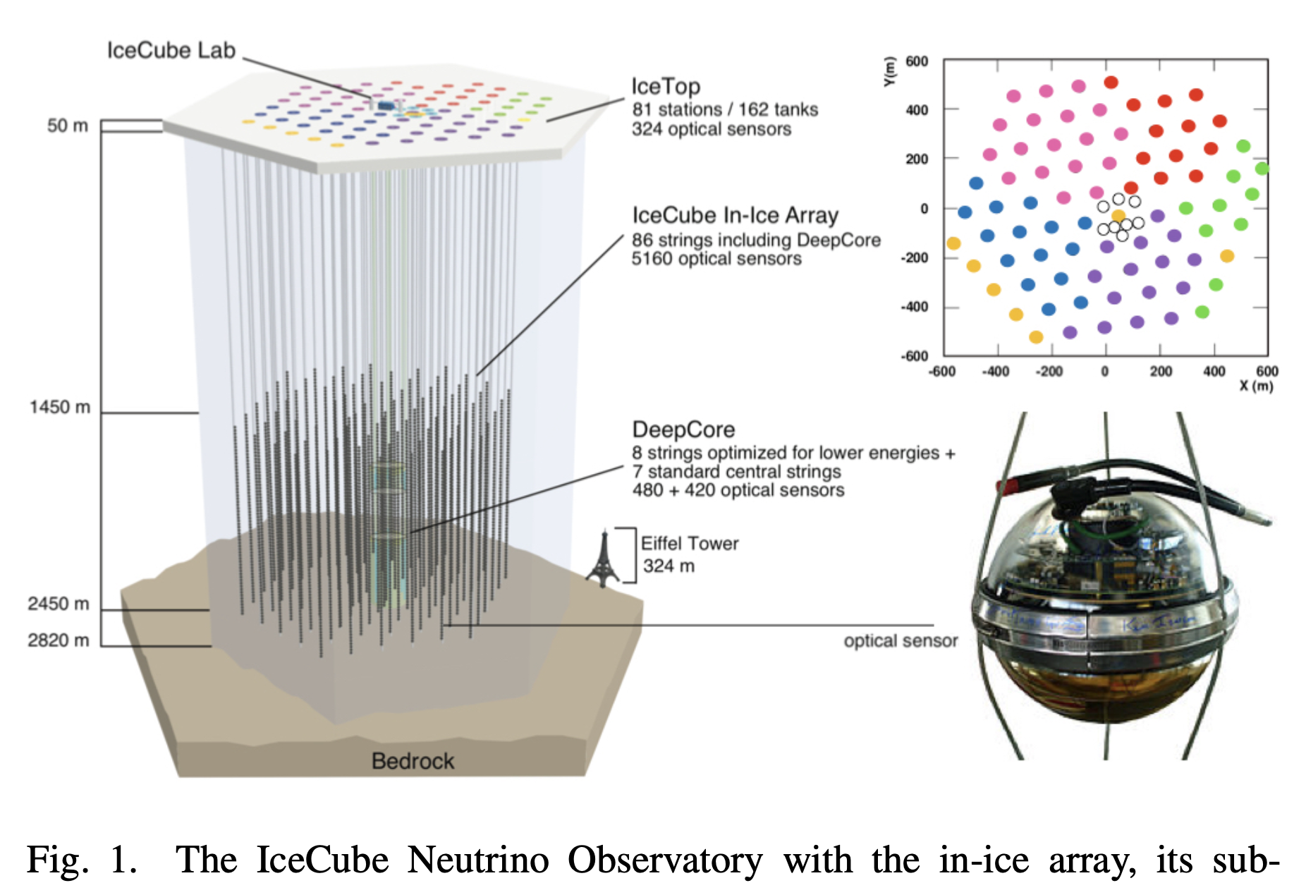
IceCube: Data
The data collected by the IceCube detector consists of signals from photomultipliers*.
*N. Choma et al. IceCube collaboration, Graph Neural Networks for IceCube Signal Classification, arXiv:1809.06166v1

Slide 11
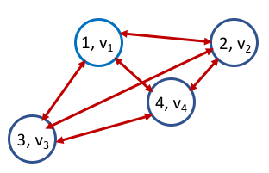
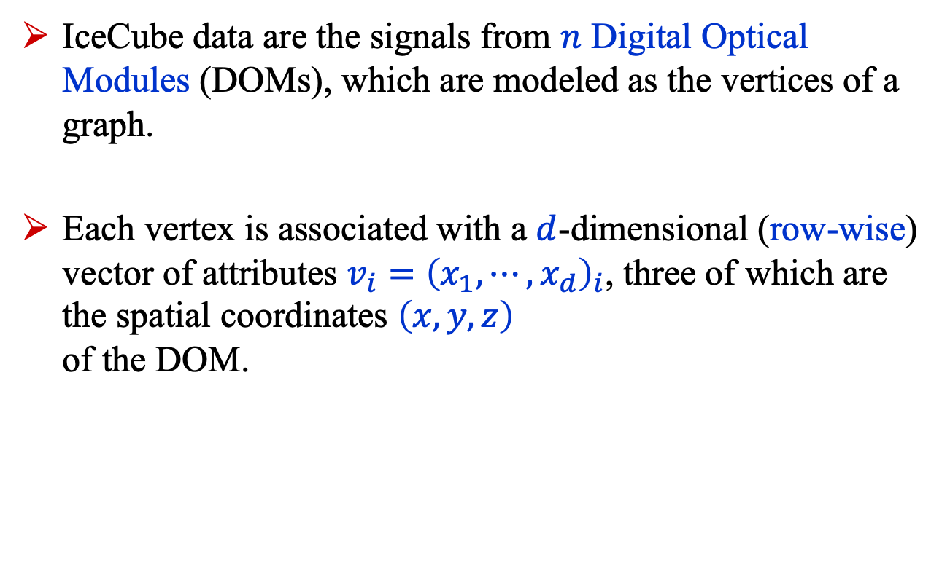
IceCube: Data
IceCube data are the signals from $n$ Digital Optical Modules (DOMs), which are modeled as the vertices of a graph.
Each vertex is associated with a $d$-dimensional (row-wise) vector of attributes $v_{i}={\left(x_{1},⋯,x_{d}\right)}_{i}$, three of which are the spatial coordinates $\left(x, y,z\right)$ of the DOM.

Slide 12
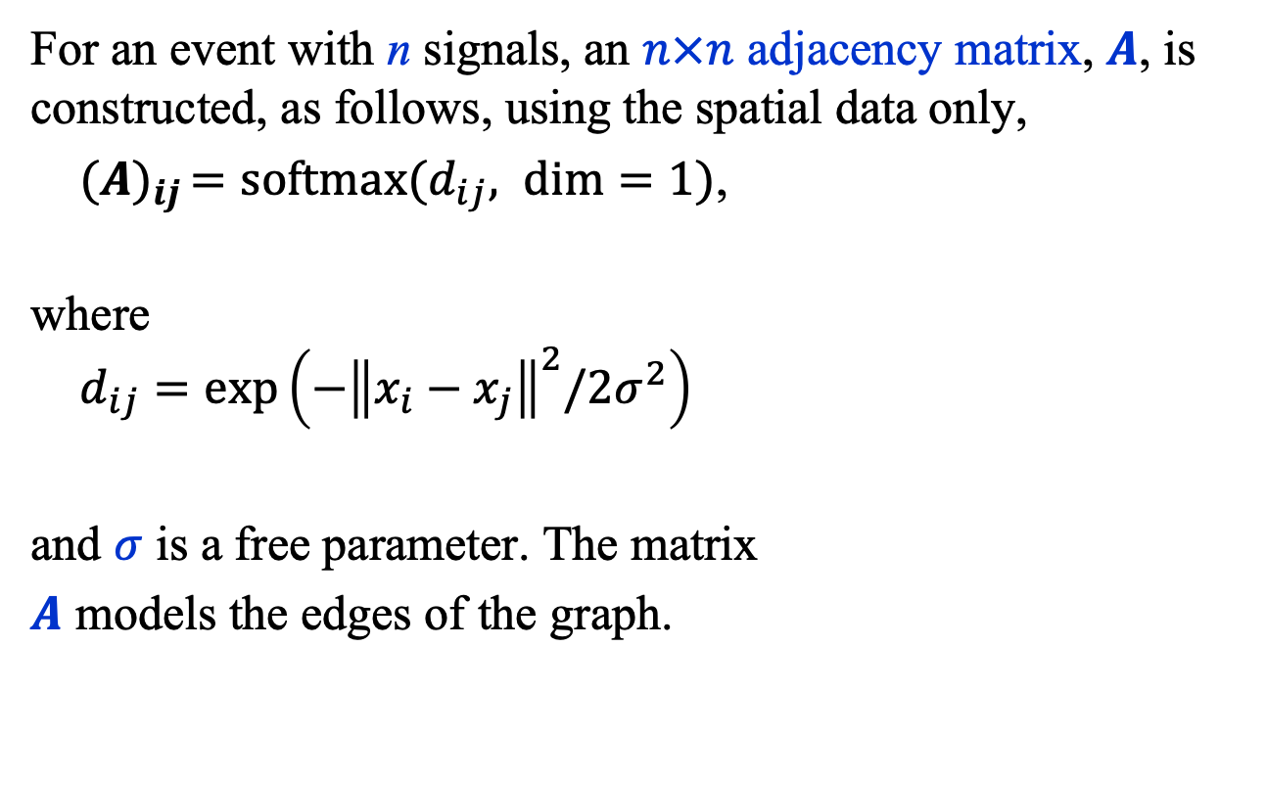
IceCube: Data
For an event with n signals, an $n×n$ adjacency matrix, $A$, is constructed, as follows, using the spatial data only,
${(A)}_{ij }=softmax(d_{ij}, dim=1)$,
where $d_{ij}=\exp\left(−{\left\|x_{i}−x_{j}\right\|}^{2}/2σ^{2}\right)$
and $σ$ is a free parameter. The matrix
$A$ models the edges of the graph.

Slide 13
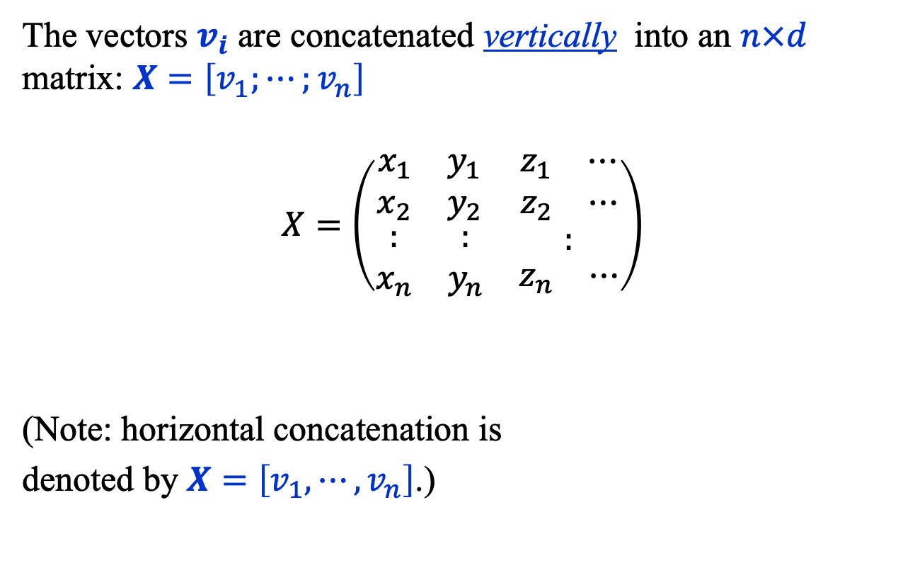
IceCube: Data
The vectors $v_{i}$ are concatenated vertically into an $n×d$ matrix: $X=\left[v_{1};⋯;v_{n}\right]$
$$X=\left(\begin{matrix}\begin{matrix}\begin{matrix}x_{1} & y_{1}\end{matrix} \\ \begin{matrix}x_{2} & y_{2}\end{matrix}\end{matrix} & \begin{matrix}\begin{matrix}z_{1} & ⋯\end{matrix} \\ \begin{matrix}z_{2} & ⋯\end{matrix}\end{matrix} \\ \begin{matrix}\begin{matrix}: \\ x_{n}\end{matrix} & \begin{matrix}: \\ y_{n}\end{matrix}\end{matrix} & \begin{matrix}: \\ \begin{matrix}z_{n} & ⋯\end{matrix}\end{matrix}\end{matrix}\right)$$
(Note: horizontal concatenation is
denoted by $X=\left[v_{1},⋯,v_{n}\right]$.)

Slide 14
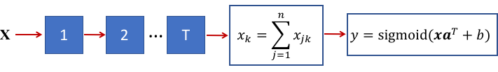
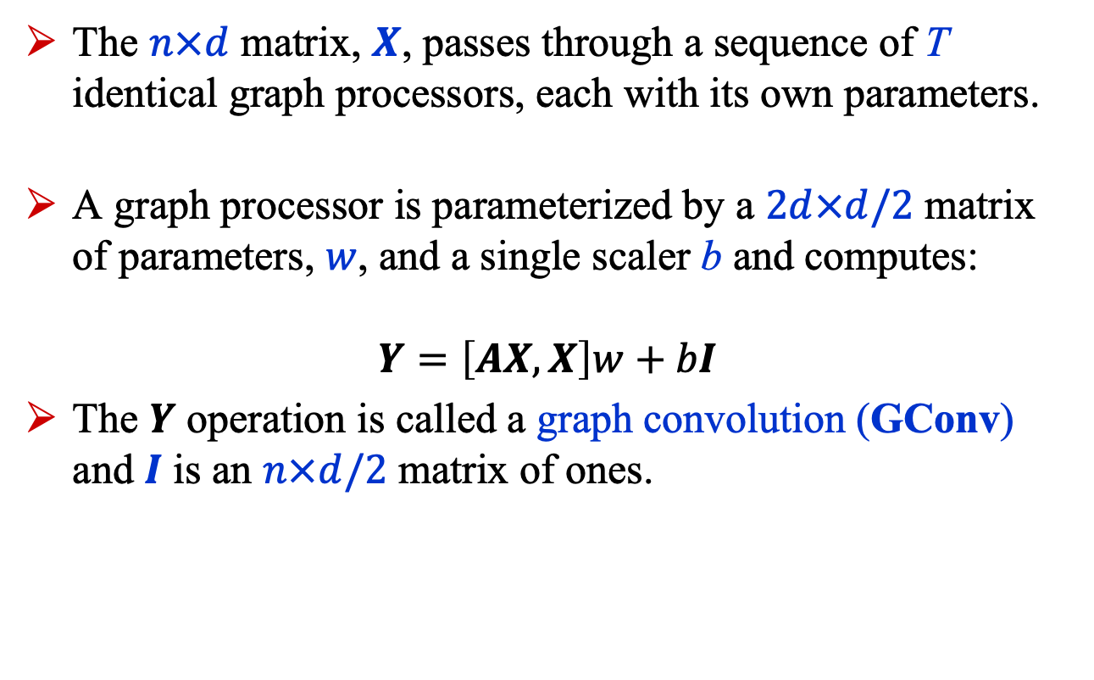
IceCube: GNN
The $n×d$ matrix, $X$, passes through a sequence of T identical graph processors, each with its own parameters.
A graph processor is parameterized by a $2d×d/2$ matrix of parameters, $w$, and a single scaler b and computes:
$$Y=\left[AX, X\right]w+bI$$
The $Y$ operation is called a graph convolution (GConv) and $I$ is an $n×d/2$ matrix of ones.

Slide 15
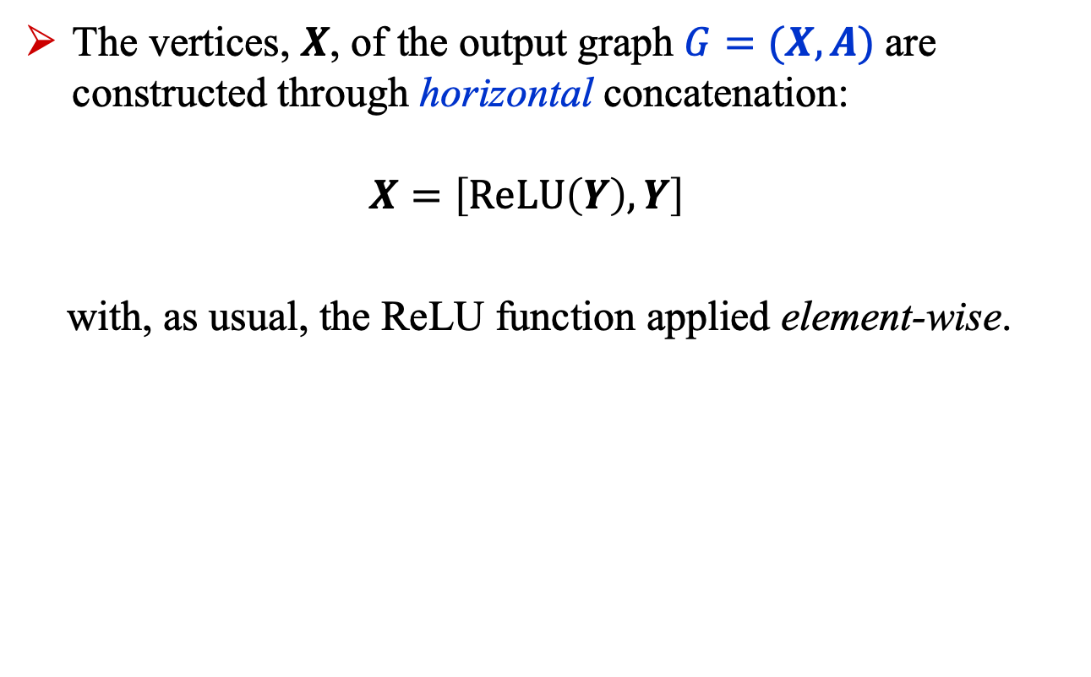
IceCube: GNN
The vertices, $X$, of the output graph $G=(X, A)$ are constructed through horizontal concatenation: $X=\left[\text{ReLU}\left(Y\right), Y\right]$
with, as usual, the ReLU function applied element-wise.

Slide 16
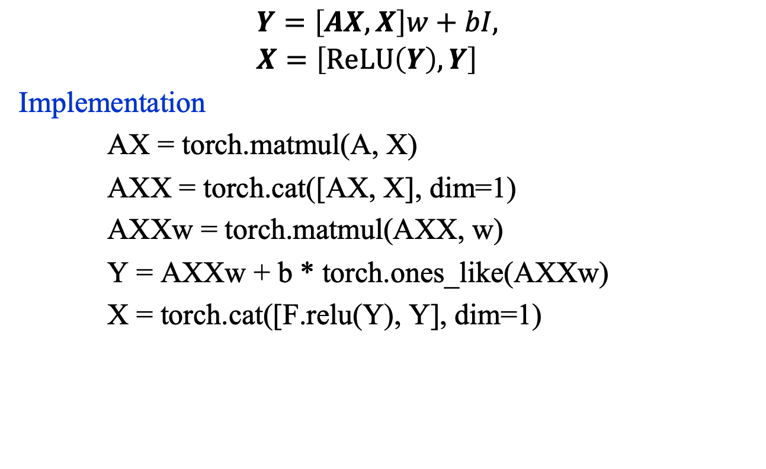
IceCube: GConv
$$Y=\left[AX, X\right]w+bI, \\ X=\left[\text{ReLU}\left(Y\right), Y\right]$$
Implementation
AX = torch.matmul(A, X)
AXX = torch.cat([AX, X], dim=1)
AXXw = torch.matmul(AXX, w)
Y = AXXw + b * torch.ones_like(AXXw)
X = torch.cat([F.relu(Y), Y], dim=1)

Slide 17
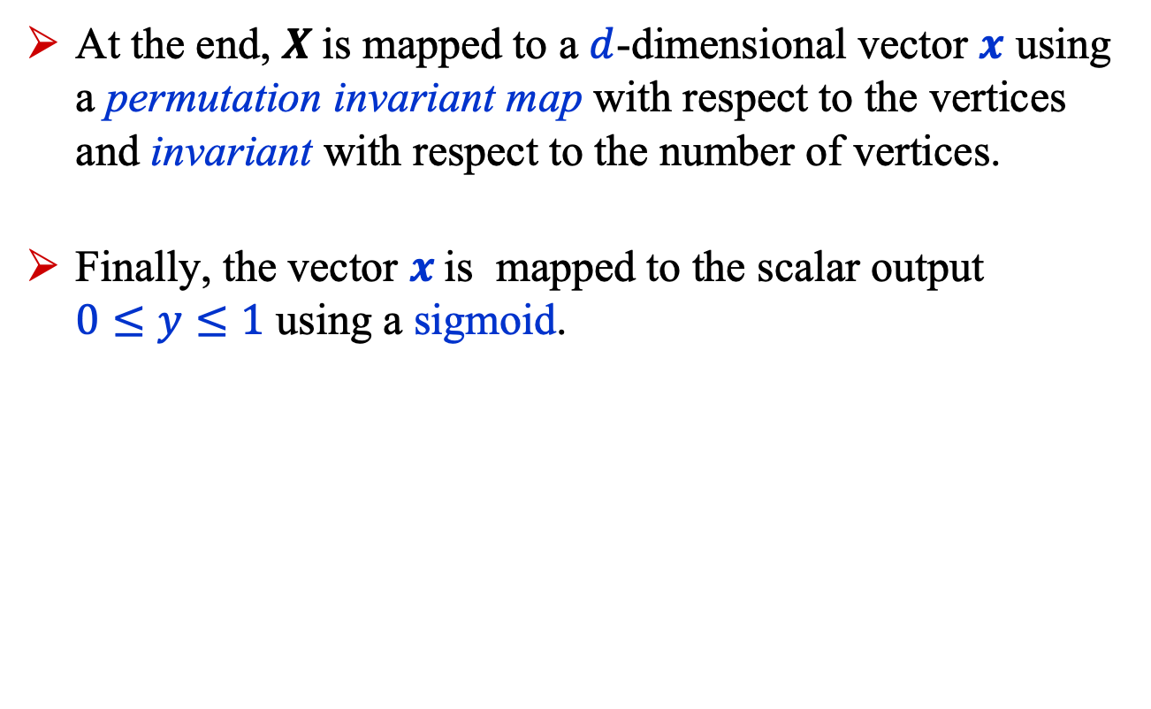
IceCube: GNN
At the end, $X$is mapped to a $d$-dimensional vector $x$ using a permutation invariant map with respect to the vertices and invariant with respect to the number of vertices.
Finally, the vector $x$is mapped to the scalar output $0≤y≤1$ using a sigmoid.

Slide 18
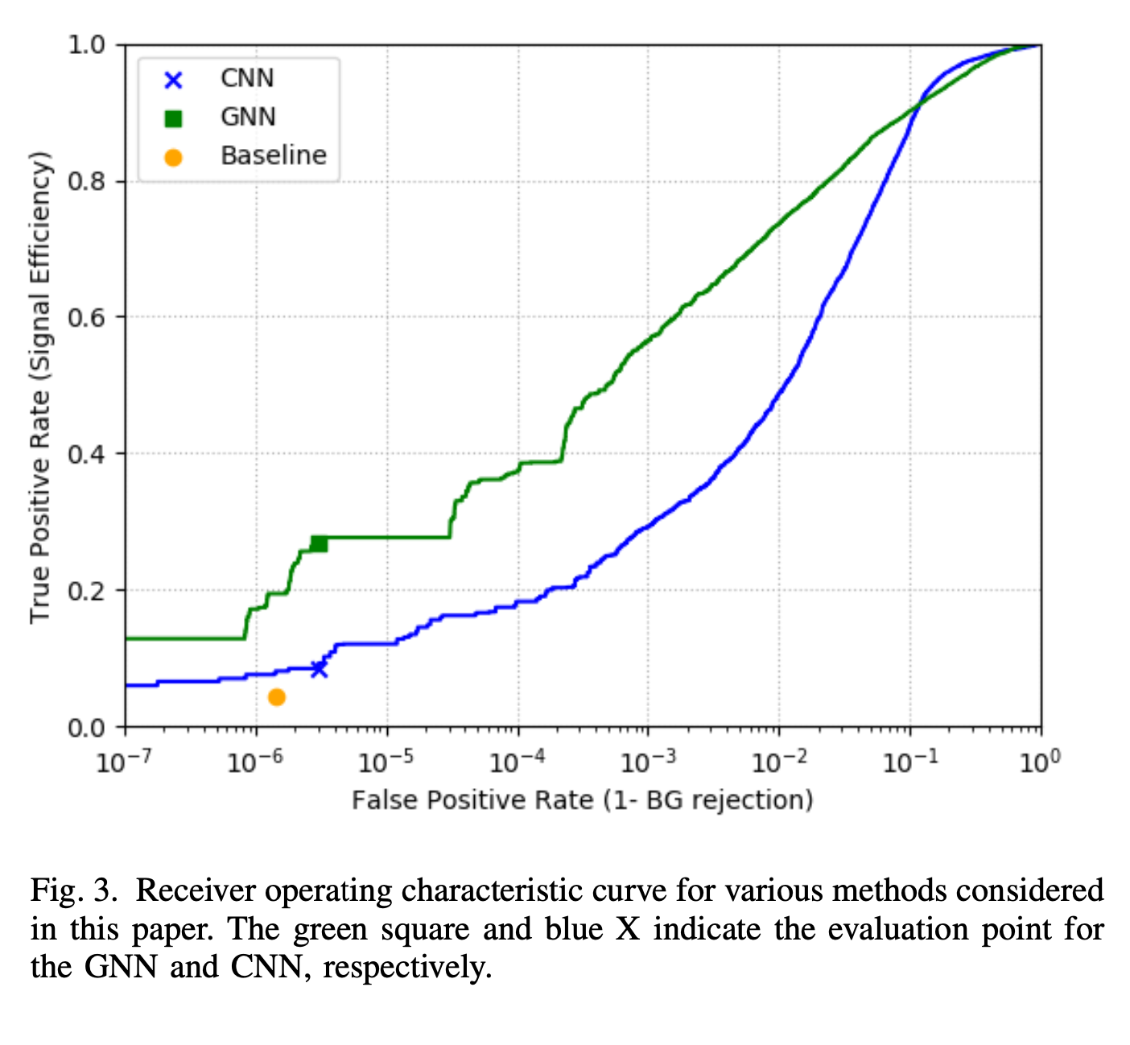
IceCube: GNN Results
The GNN is 6.3 times
more efficient than the
IceCube physics baseline
analysis at a signal to
noise ratio that is 3
times better.
It also outperforms a
3D CNN.

Slide 19
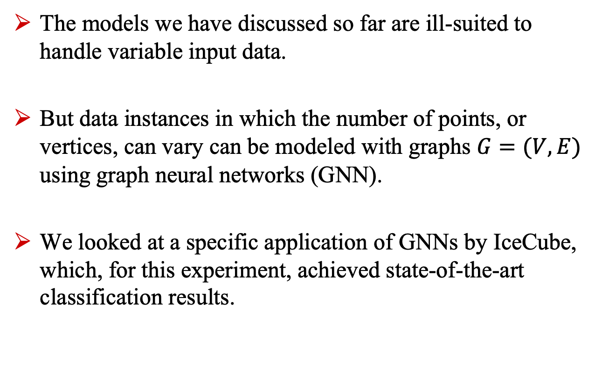
Summary
The models we have discussed so far are ill-suited to handle variable input data.
But data instances in which the number of points, or vertices, can vary can be modeled with graphs $G=(V, E)$ using graph neural networks (GNN).
We looked at a specific application of GNNs by IceCube, which, for this experiment, achieved state-of-the-art classification results.

